Slide 1


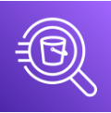
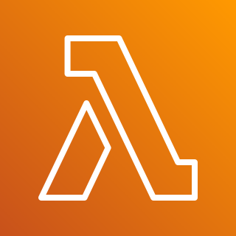




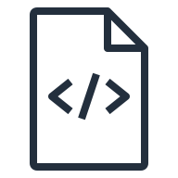
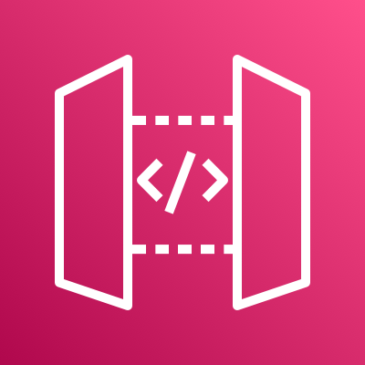

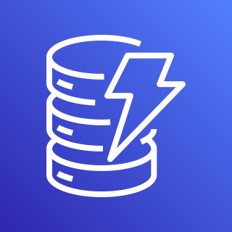



Sample
1
Amazon Athena is used to query, and export historical user interaction data from Google Analytics via Google BigQuery to Amazon S3. This data is used to train the Amazon Personalize user recommendation model
User interacts with a website, or a mobile app that uses Google Tag Manager (GTM) Tags to track user interactions
A GTM Tag submits the user interaction event to Amazon API Gateway. The user event record is put to Amazon Kinesis. An AWS Lambda reads the records from Amazon Kinesis stream, and submits it to Amazon Personalize
A GTM tag gets recommendations for the user. Amazon Personalize recommends items using the Recommended For You recipe
Advanced Composite Recipe: User adds items to their cart. A GTM Tag requests for recommended items for cross-sell. An AWS Lambda gets similar items recommendations from Amazon DynamoDB, and re-ranks with a User Personalized Ranking recipe in Amazon Personalize including Promotional items
An Amazon EventBridge time based event triggers an AWS Lambda, which starts an Amazon Personalize batch inference to gets similar items. Inference results are stored in Amazon S3, and an AWS Lambda writes them to Amazon DynamoDB for use in the Advanced Composite Recipe.
AWS Cloud
2
1
3
Amazon Athena
Amazon S3
Amazon Personalize
Google BigQuery
AWS Lambda
3
4
Amazon Kinesis
Amazon Personalize
Google Analytics
AWS Lambda
4
2
5
Amazon Personalize
AWS Lambda
Website/App with Google Tag Manager
Amazon API Gateway
Advanced Composite Recipe
5
Amazon DynamoDB
AWS Lambda
Amazon S3
Amazon Personalize
6
6
AWS Lambda
Clients
Amazon Personalize
AWS Lambda

Slide 2



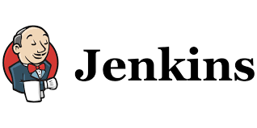
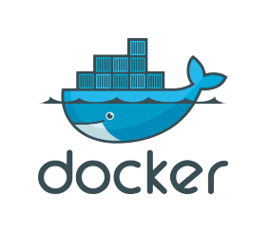
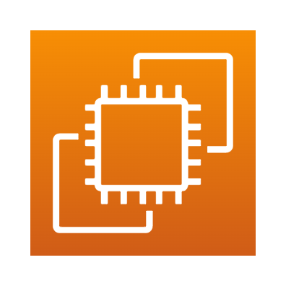

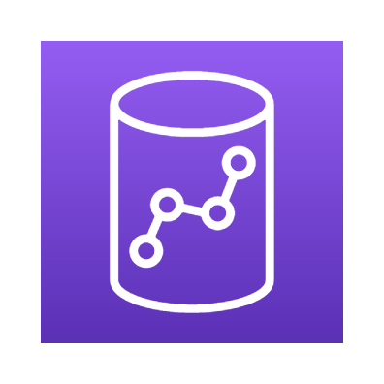
Guidance for DevOps for Redshift
1
A developer adds/modifies DDL/DML scripts in configuration files and commits them into GitHub for deployment.
GitHub uses a webhook to start the build process on Jenkins. Declarative pipeline job in Jenkins is kicked to start the build process.
Jenkins builds a docker container image using the configuration specified in the docker file. Once an image is built Jenkins job pushes the image to docker hub.
Jenkins job pulls the latest docker hub image and creates a new container, executes the DDL/DML scripts specified in the configuration file.
A docker container with latest image is executed to deploy the changes in multiple environments. Logs, test results in the docker container are saved to mapped ec2 directory.
Code executed in docker container checkpoints each executed step from config files and saves it in s3 bucket. In event of container restart, last saved checkpoint is used for execution.
2
3
3
4
5
1
2
4
Developer
Git
TST
6
Run Docker Container
5
EC2 Host
Amazon Redshift
6
PROD
Run Docker Container
S3 bucket
Amazon Redshift

Slide 3
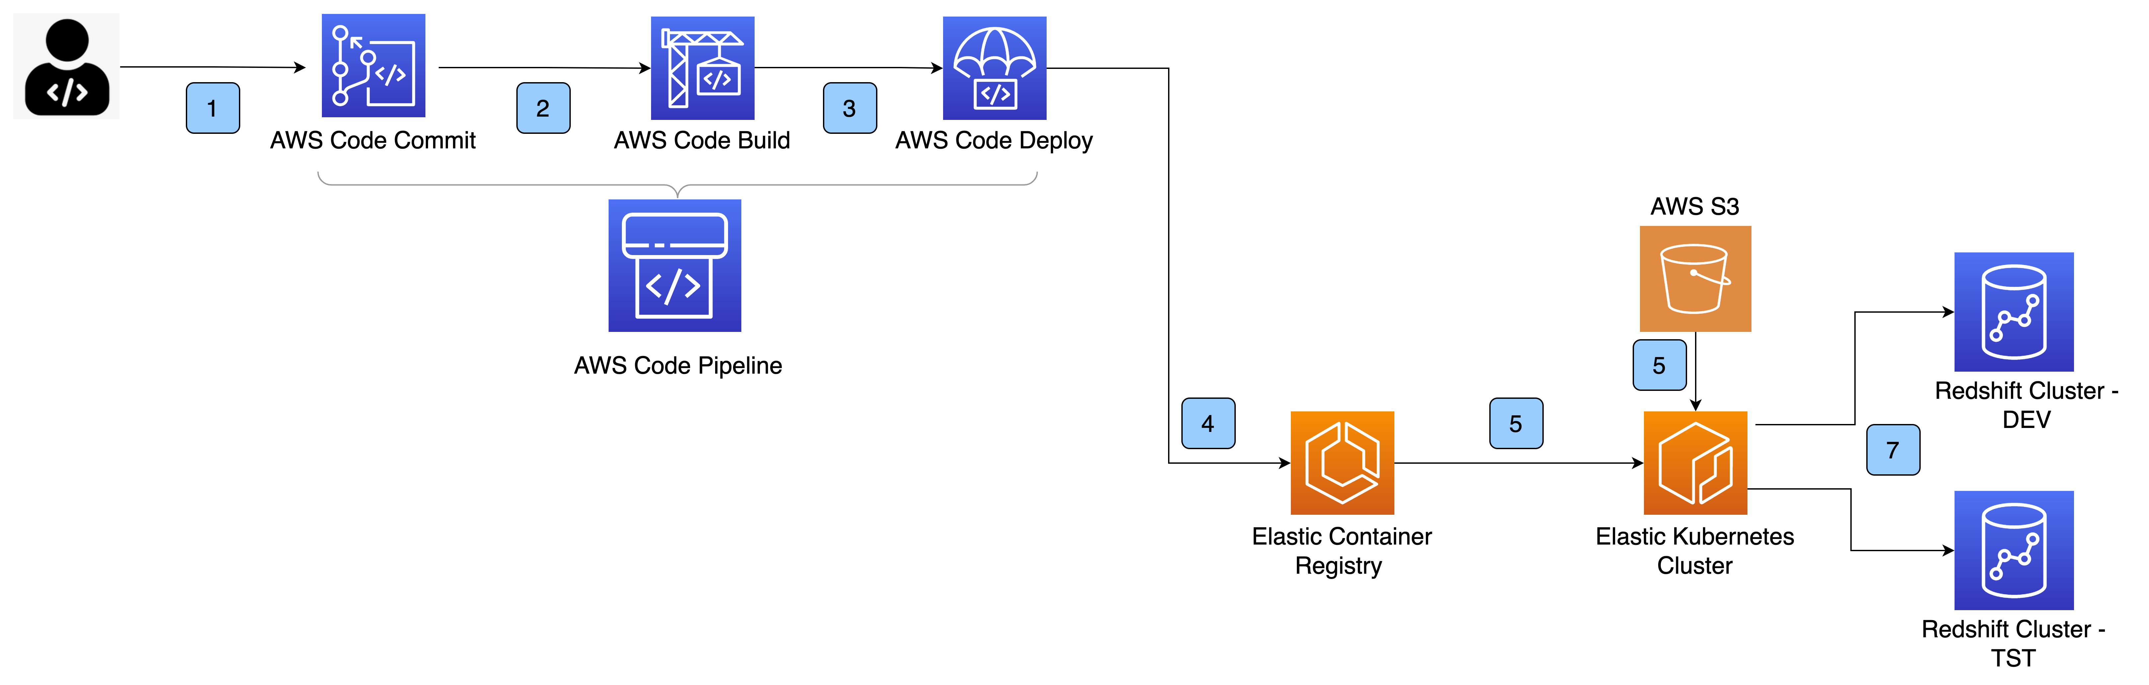
Guidance for DevOps for Redshift – AWS Native
1
A developer adds/modifies DDL/DML scripts in configuration files and commits changes into AWS code commit .
AWS code commit triggers off a code build using configuration specified in buildspec.yml. The build happens based on pre_build, build and post_build command.
AWS code builds the container image and pushes it to AWS code deploy.
Code deploy pushes the container image to Elastic container Registry (ECR) repository.
EKS cluster picks up the container image , reads configuration in s3 bucket to determine execution step, connects with Redshift cluster and executes DDL/DML code.
Code gets deployed in Redshift cluster environment, task completes and the deployment service waits for another change to DDL/DML script.
2
3
4
5
6

